Slide 1
Chapter 11: Image Topology
11.1 Introduction
Image geometry studies rotation, translation,
scaling, distortion, etc.
Image topology studies, e.g.,
(i) the number of occurrences of a particular
object,
(ii) whether or not there are holes in an object,
(iii) the connectivity of an object, etc.
15-<number>

Slide 2
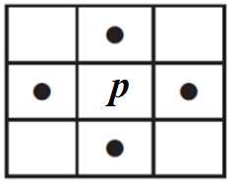
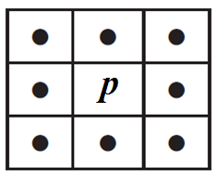
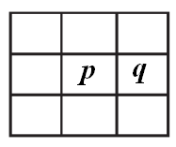
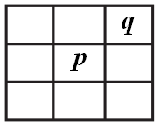
11.2 Neighbors and Adjacency
4-neighbor
8-neighbor
4-adjacent
8-adjacent
15-<number>

Slide 3
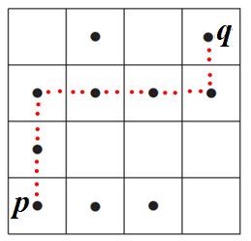
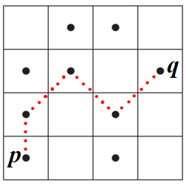
11.3 Paths and Components
If p and q can be joined by a sequence of pixels
and the path contains only 4-adjacent pixels, p and
and q are 4-connected.
If the path contains 8-adjacent pixels, p and q are
8-connected.
15-<number>

Slide 4
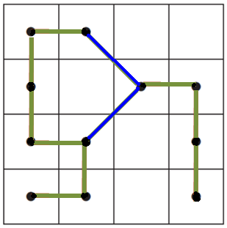
A set of pixels, all of which are 4-connected to each
other, forms a 4-component. If all the pixels are
8-connected, the set forms an 8-component.
e.g., How many 4-components and 8-components
are in the following figure?
Two 4-component
One 8-component
15-<number>

Slide 5
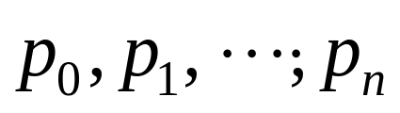

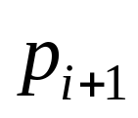



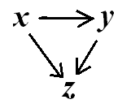
4-path: a sequence of pixels such that
for each is 4-adjacent to .
8-path: the pixels in the sequence are 8-adjacent.
11.4 Equivalent Relations
Relation x ∼ y is an equivalence relation if it is
(i) Reflexive, x ∼ x for all x,
(ii) Symmetric, x ∼ y and y ∼ x for all x and y
(iii) Transitive, if x ∼ y, y ∼ z,
then x ∼ z for all x, y, and z.
15-<number>

Slide 6
Examples of equivalence relations:
(i) Numeric equality – if x and y are two numbers
for which x = y
(ii) Divisor – if x and y have the same remainder
when divided by a divisor
(iii) Set cardinality – if S and T are two sets with
the same number of elements
(iv) Connectedness – if p and q are two connected
pixels
15-<number>

Slide 7
Examples of relations that are not equivalence ones
i) Personal relations,
ii) Pixel adjacency
iii) Subset relation
Equivalence class: the set of all objects that are
equivalent to each other
Connected component: an equivalence class of
connectedness equivalence relation
15-<number>

Slide 8
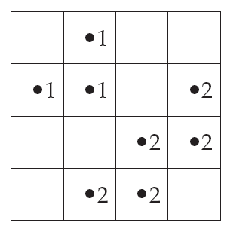
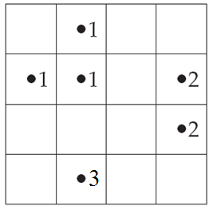
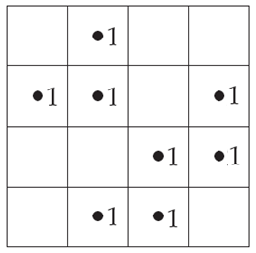
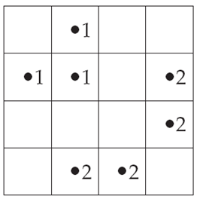
11.5 Component Labeling
4-components
8-components
An algorithm for labeling 4-components of a binary image
If p is a background pixel, move to the next
pixel,
Otherwise,
15-<number>
Notes:
4-(connected)-components

Slide 9
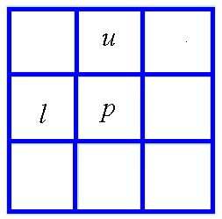
(a) if both u and l are background
pixels, assign a new label to p
(b) if one of u and l is a foreground
pixel, assign its label to p
(c) if both u and l are foreground pixels and have
the same label, assign that label to p
(d) if both u and l are foreground pixels but have
different labels, assign either label to p and
record that those two labels are equivalent.
15-<number>

Slide 10
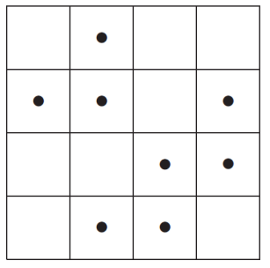
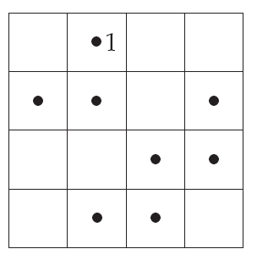
2. Sort the labels into equivalent classes and assign a different label to each.
3. Do a second pass through the image, replacing the label on each foreground pixel with the label assigned to its equivalent class.
Example:
Step 1: We start moving along the
top row. The first foreground pixel
is the dot in the second place, and
since its upper and left neighbors
are either background pixels or
nonexistent, we assign it the label 1.
15-<number>

Slide 11
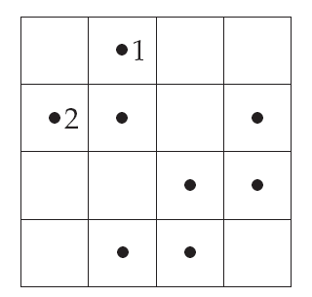
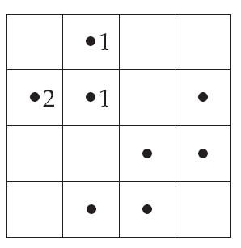
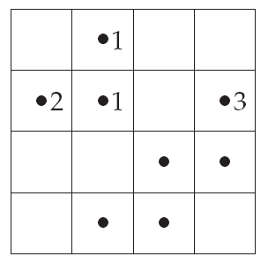
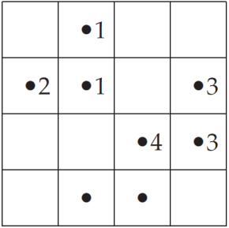
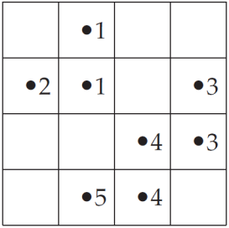
Step 2: We have the following equivalence classes
of labels: {1,2 } and {3,4,5}.
Assign label 1 to the first class and label 2
to the second class.
15-<number>

Slide 12
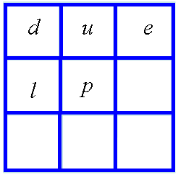
Step 1 of the above algorithm can be modified for
labeling 8-components of a binary image
Modified step 1:
If p is a background pixel,
move to the next pixel,
Otherwise,
(a) if d, u, e and l are background pixels,
assign a new label to p
(b) if one of them is a foreground pixel,
assign its label to p
(c) if two or more are foreground pixels,
assign any of their labels to p and make
a note that all their labels are equivalent.
15-<number>

Slide 13
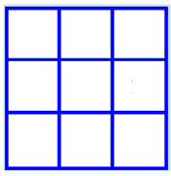
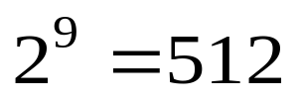
11.6 Lookup Tables
Example: Boundary detection in a binary image
Considering the 3 by 3 neighborhood of
a foreground pixel, there are
different neighborhoods.
A lookup table is a binary vector of length 512,
each entry (either 0 or 1) representing the result
of boundary detection of the neighborhood of a
foreground pixel.
15-<number>

Slide 14
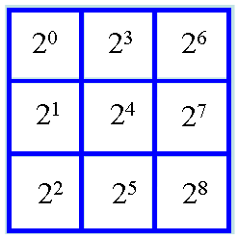
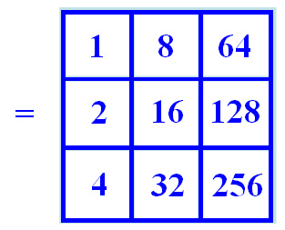
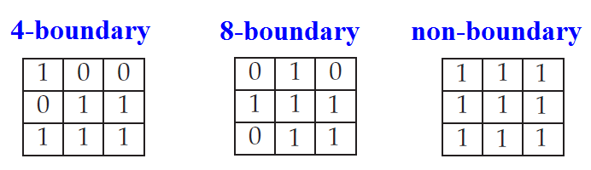
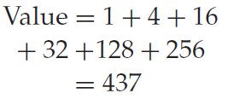
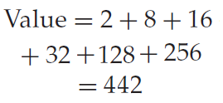
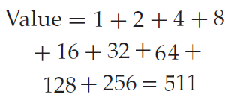
weight
matrix
Define
The value of a neighborhood is obtained by
adding the weights of 1-valued pixels, e.g.,
15-<number>

Slide 15
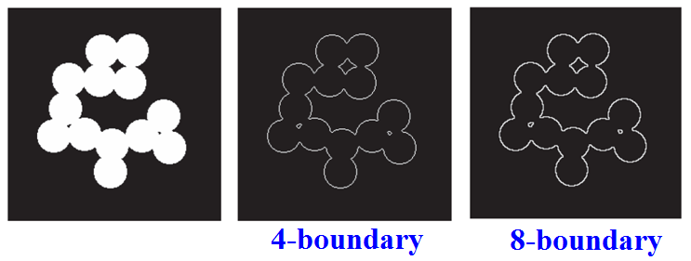
The value then serves as the index to the lookup
table.
The foreground pixel under consideration is a
boundary pixel if the entry of the lookup table
indexed by the value is 1.
15-<number>

Slide 16

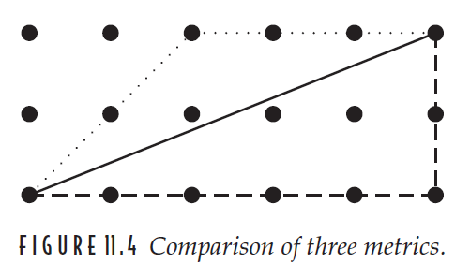

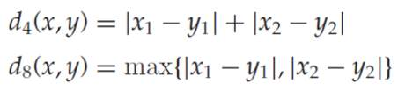
11.7 Distances and Metrics
A distance function d(x, y) is called a metric if it
satisfies the following:
(i) d(x, y) = d(y, x) (symmetry)
(ii) d(x, y) ≥ 0 and d(x, y) = 0 iff x = y (positivity)
(iii) (the triangle
  inequality)
e.g.,
15-<number>

Slide 17
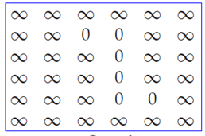
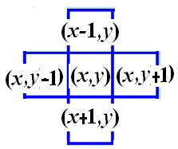
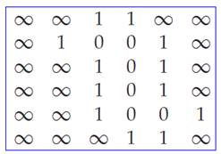
11.7.1 Distance Transform
Assign each pixel in
region R with value
0 and each pixel not
in R with ∞
For each pixel (x, y),
replace its value with
min{v(x, y), v(x+1, y)+1,
v(x−1, y)+1, v(x, y−1)+1,
v(x, y+1)+1}
15-<number>

Slide 18
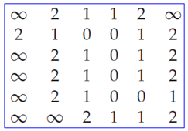
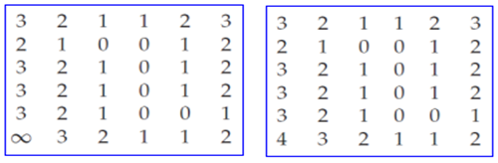

3. Repeat Step 2 until all values have been converted to finite values
Consider mask:
for
min{ d(x, y), d(x+1, y)+1, d(x−1, y)+1, d(x, y−1)+1,
d(x, y+1)+1 }
15-<number>

Slide 19

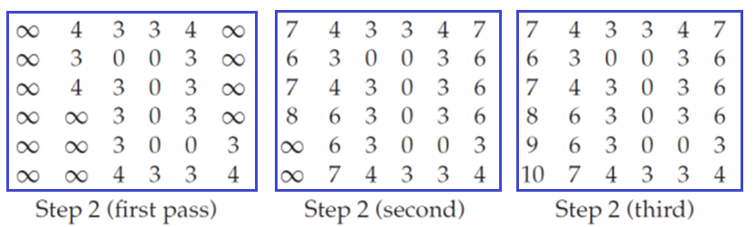
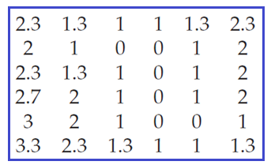
Another mask:
Divide all values by 3
15-<number>

Slide 20
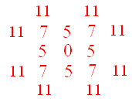
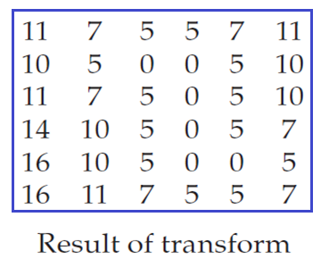
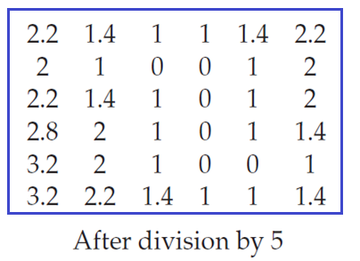
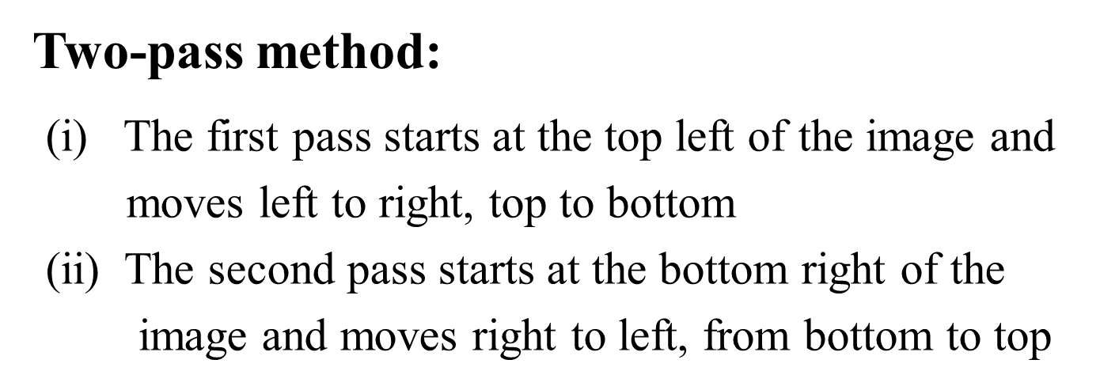
Another mask:
15-<number>
Notes:
只需兩步驟

Slide 21
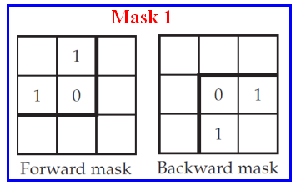
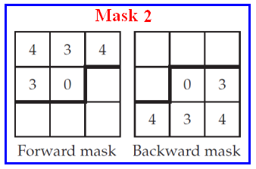
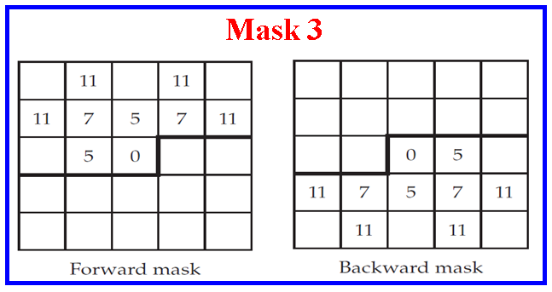
15-<number>

Slide 22
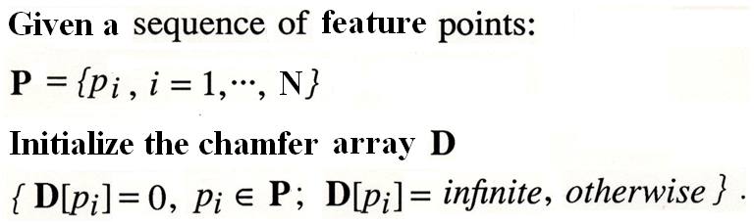
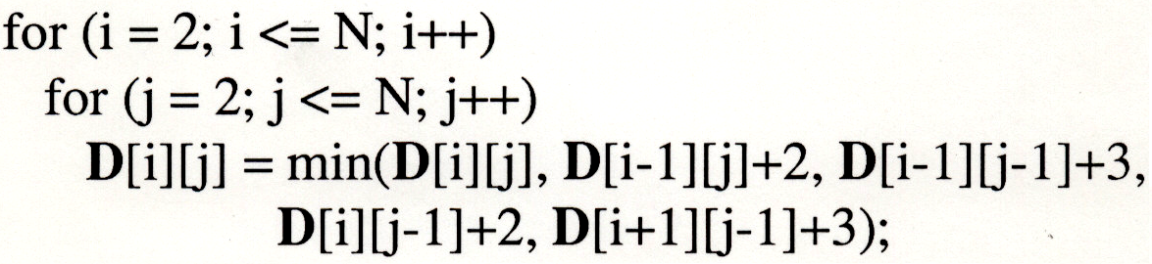


Algorithm 1:
15-<number>

Slide 23

Algorithm 2:
15-<number>

Slide 24




Examples:
15-23
Notes:
distance table:
可在character recognition 扮演重要角色
robotics也常用

Slide 25

11.8 Skeletonization
Skeleton consists of lines and curves which provide
information about the size and shape of an object.
15-<number>

Slide 26

Definition: the skeleton of an object is the medial
axis of the object. A pixel is on the
medial axis if it is equidistant from
at least two boundary pixels of the
object.
15-<number>

Slide 27



Difficulty: small changes to an object can result
in large changes to the skeleton.
15-<number>

Slide 28

Skeletonization by iteratively removing deletable
pixels
Deletable pixels: the pixels that can be deleted
without changing (i) the connectivity of an
object, (ii) the number of components, (iii)
the number of holes.
Nondeletable pixels:
(i)
15-<number>

Slide 29


(ii)
(iii)
How to check to see whether or not a pixel is
deletable.
15-<number>

Slide 30


4-simple: a pixel that can be deleted without
changing the 4-connectivity of the object
8-simple: a pixel that can be deleted without
changing the 8-connectivity of the object
Examples:
The central pixel is neither
4-simple nor 8-simple
The central pixel is 8-simple
but not 4-simple
How to check to see whether a foreground pixel p is 4-simple or 8-simple.
15-<number>

Slide 31






Define : the 3 by 3 neighborhood of p
: the 3 by 3 neighborhood
excluding p
A(p) : #4-components in
C(p) : #8-components in
B(p) : #foreground pixels in
e.g., i)
15-<number>

Slide 32


ii)
A foreground pixel p is 4-simple, iff, A(p) = 1
and is 8-simple, iff, C(p) = 1.
Simple points can be characterized entirely in terms of A(p) and C(p).
15-<number>

Slide 33


Zhang-Suen Skeletonization Algorithm
Mark foreground pixel p to be deletable, if
1) 2 ≤ B(p) ≤ 6, 2) A(p) = 1,
3) i. For odd iteration, delete p if
it is on the right-hand side,
or the bottom of an object,
or on a northwest corner, e.g.,
ii. For even iteration, delete p
if it is on the left-hand side,
or top of an object, or on a
southeast corner, e.g.,
15-<number>

Slide 34


Example:
15-<number>

Slide 35

15-<number>

Slide 36

Guo-Hall Skeletonization Algorithm
Imagine the image grid being
labeled with 1s and 2s in a
chessboard configuration:
1. At odd step, mark foreground pixels p labeled 1, if C(p) = 1 and B(p) > 1;
At even step, mark foreground pixels p labeled 2, if C(p) = 1 and B(p) > 1;
2. Delete all marked pixels,
3. Continue until no deletions are possible.
15-<number>

Slide 37


Example:
Superimpose a chessboard of 1s and 2s.
Step 1: Delete only those foreground pixel p
labeled 1 that satisfy C(p) = 1 and B(p) > 1;
Step 1:
Step 2:
15-<number>

Slide 38



Step 3:
Step 4:
Example:
Real images
15-<number>

Slide 39




Distance Transform Skeletonization Method
Example:
Input
Distance
Transform
Skeleton
pixels
15-38

Slide 40




Example: Real image
15-<number>

